Slide 1
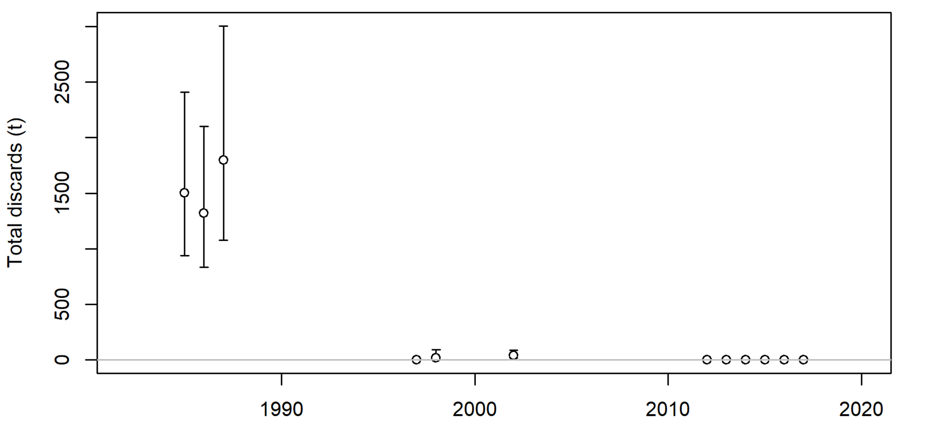
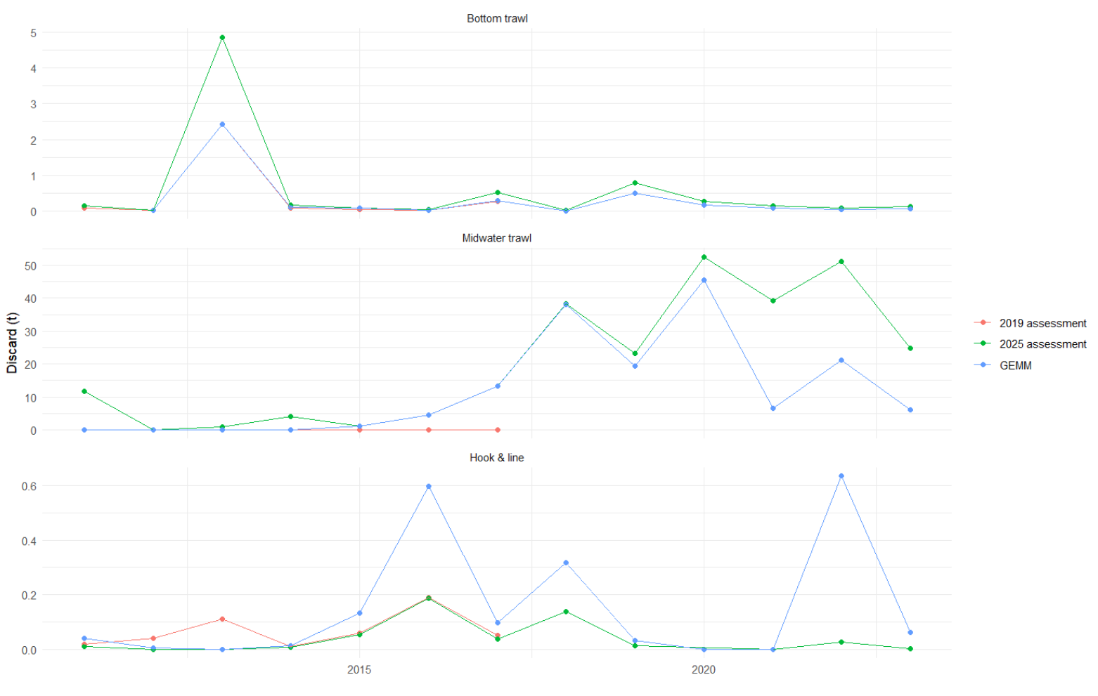
Widow rockfish MDT discard
To fit discard amount (or fraction) the model uses the retention asymptote (retention parameter 3 in the selectivity section of the control file)

Slide 2
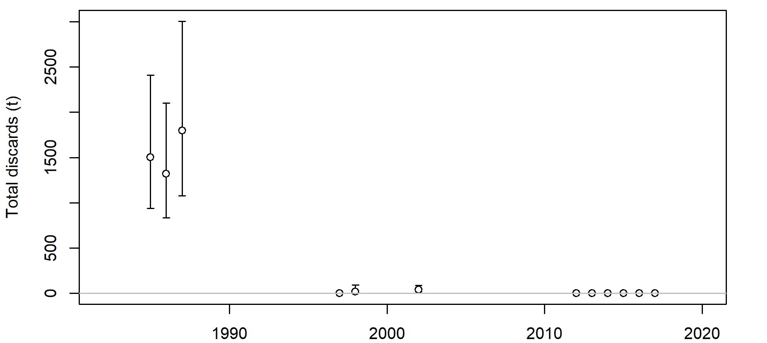
2019 model time varying retention asymptote
Block 1916-1982:
fixed at base value
Block 1983-2001:
Retention asymptote estimated
Block 2002-2010: estimated
Base parameter
2011 forward:
Retention asymptote fixed at a low value

Slide 3
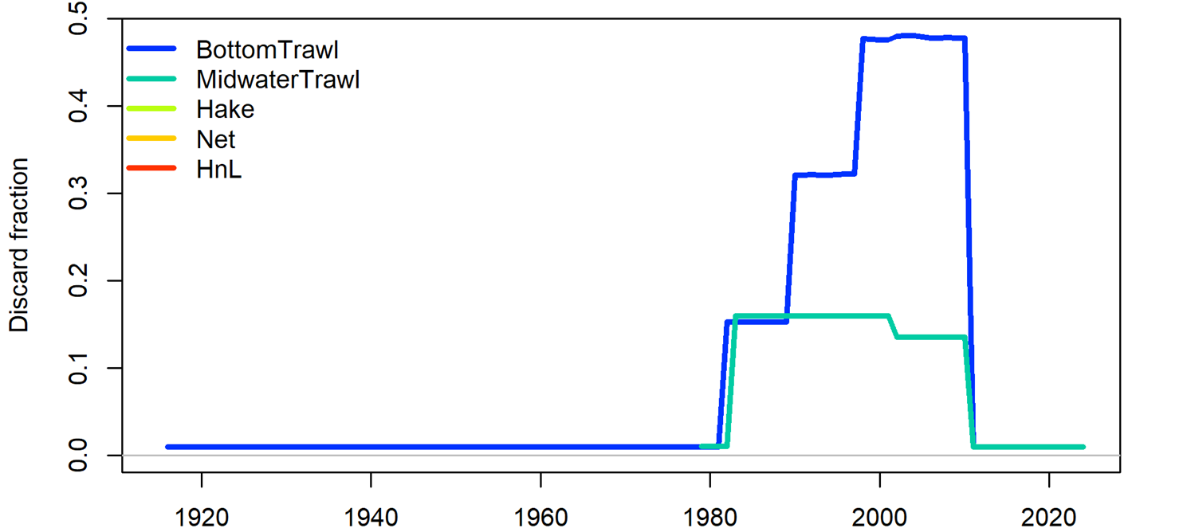
2019 model time varying retention asymptote
Block 1983-2001
Block 2002-2010
Base parameter
Block 1916-1982

Slide 4
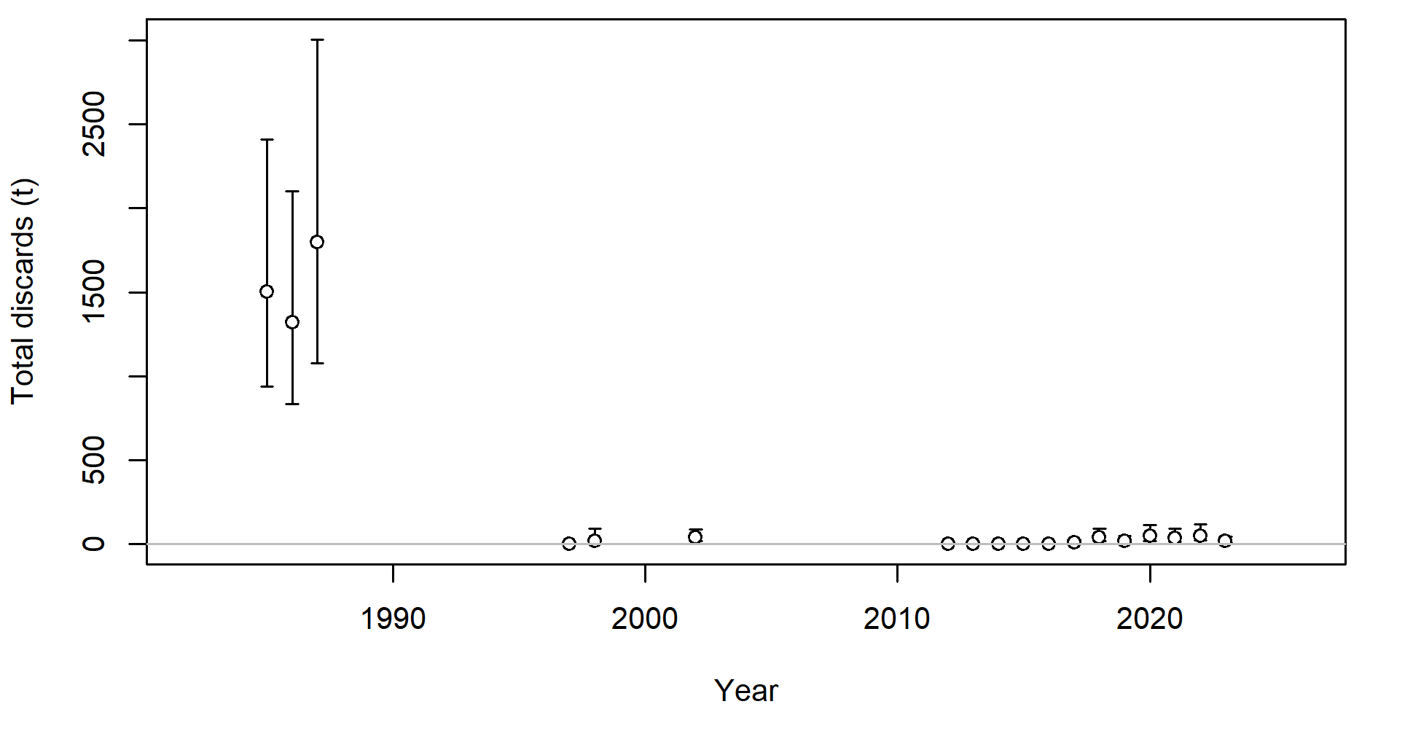
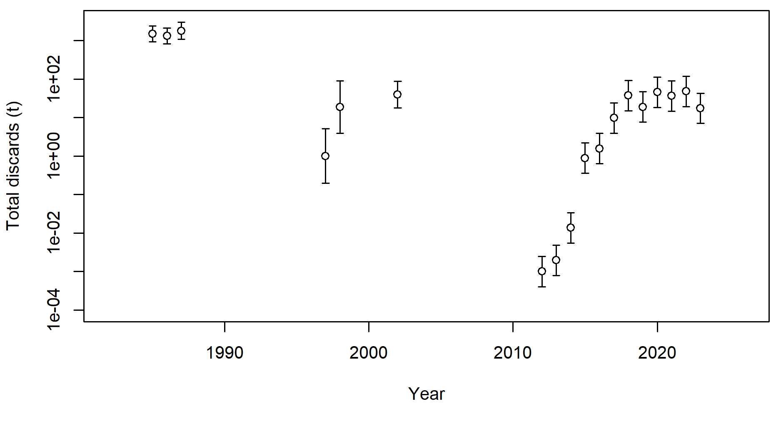
2025 model time varying retention asymptote

Slide 5
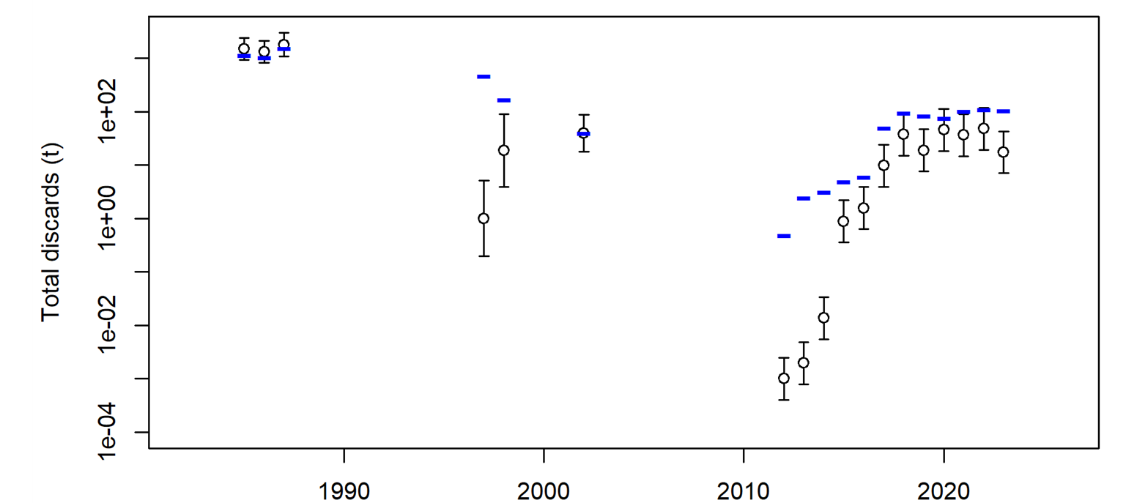
2025 model time varying retention asymptote
Block 1916-1982:
fixed at base value
Block 1983-2001: estimated
Block 2002-2010: estimated
Base parameter
2011 forward (fixed)

Slide 6
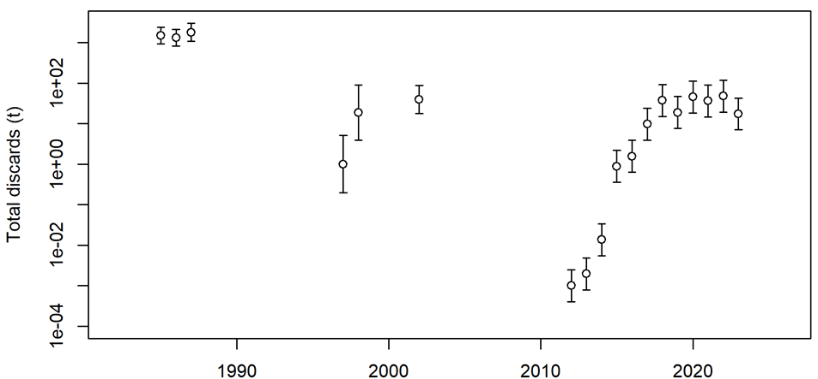
2025 model time varying retention asymptote
Block 1916-1982:
fixed at base value
Block 2011-2016:
fixed (just like in was in 2019 base parameter)
Block 1983-2001: estimated
Block 2002-2010: estimated
Base parameter
2017 forward’
estimated

Slide 7
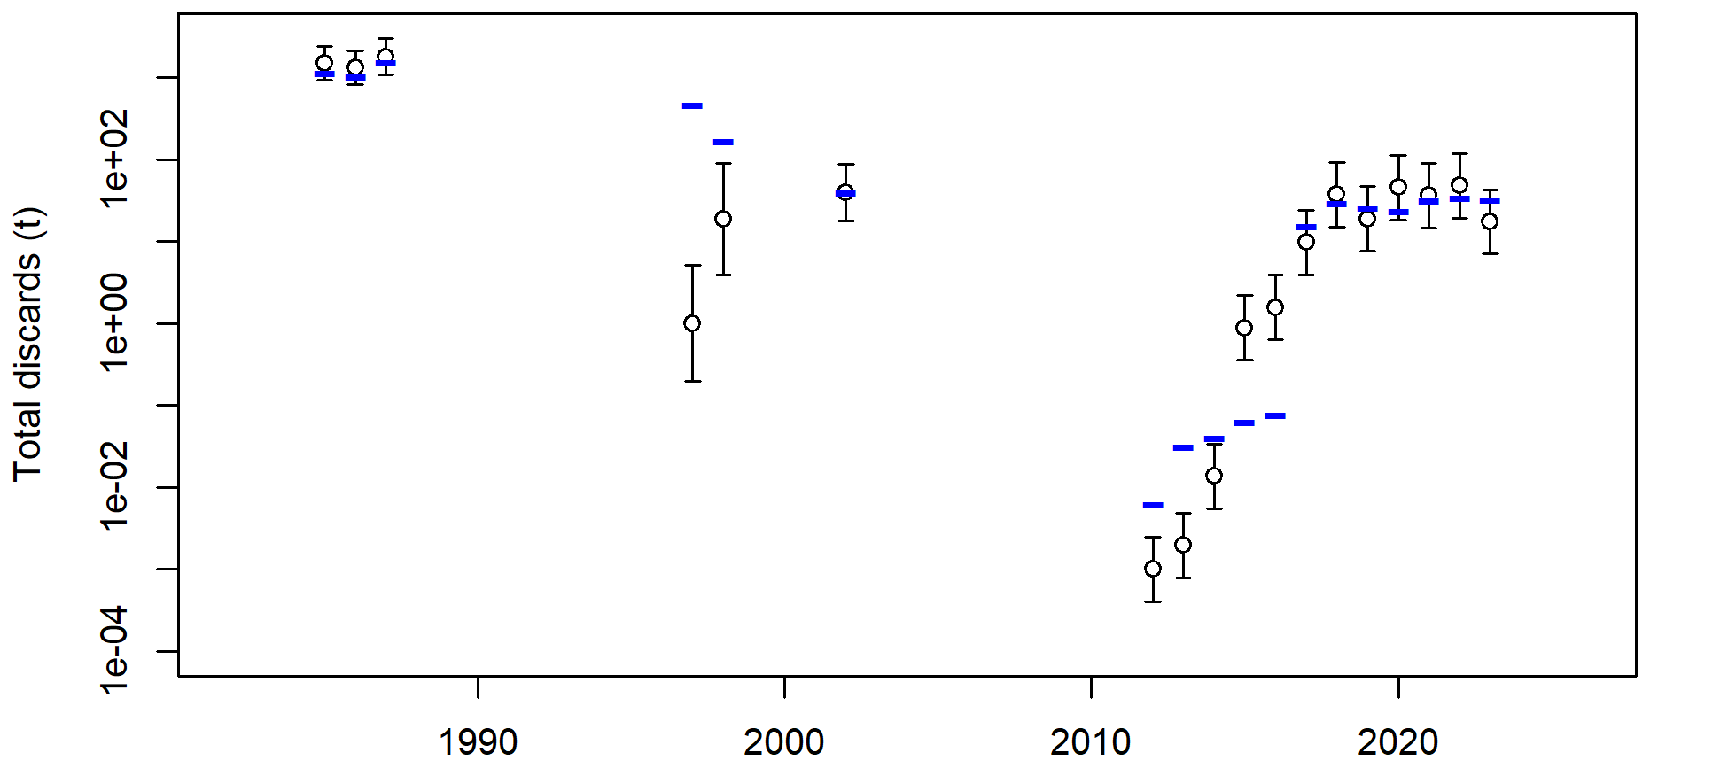
2025 model time varying retention asymptote
Block 1916-1982:
fixed at base value
Block 2011-2016:
fixed
Block 1983-2001: estimated
Block 2002-2010: estimated
Base parameter
2017 forward
estimated

Slide 8
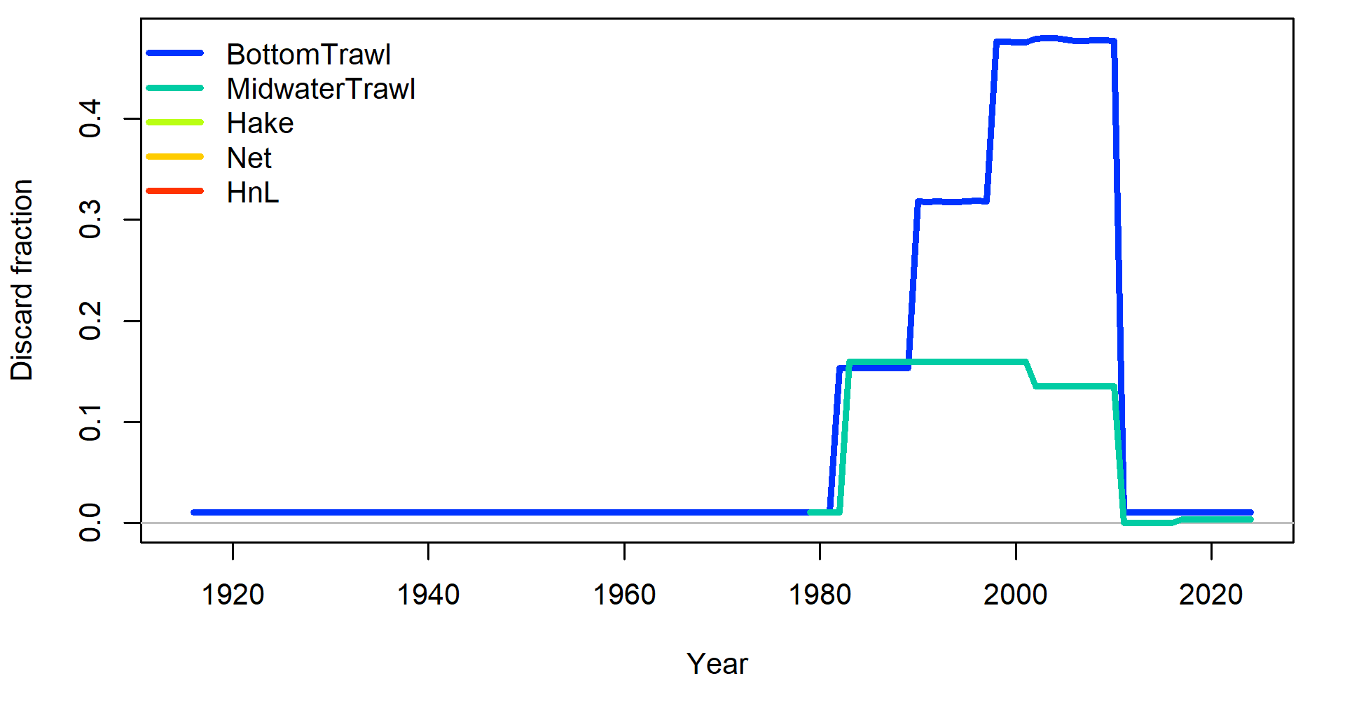
2025 model time varying retention asymptote

Slide 9
Adding a new block pattern
Retention in 2019 model used block pattern 7 was used for selectivity and retentioan parametets (not only retention)
We duplicated block pattern 7, and named it block pattern 12
Added a new block (2011-2016) to pattern 12
Used that new block pattern 12 to only retention asymptote.

